Slide 1
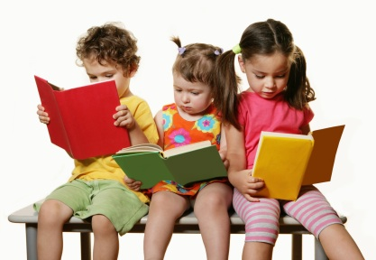
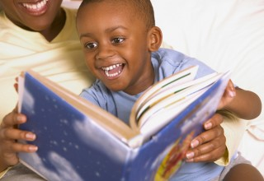
Early literacy for Young children
This Photo by Unknown Author is licensed under CC BY-NC-ND and CC BY-SA

Slide 2
Early literacy
Literacy begins at an early age and is defined as “a set of complex understandings, attitudes, expectations and behaviors […] related to written language” (Erickson, 1984; Cook-Gumperz, 1986).
There are many opportunities to help strengthen your child’s literacy knowledge including:
reading,
talking,
asking questions,
singing,
story telling and
scribbling
“The most effective action you can take to increase your [child’s] educational opportunities and future success is to talk with your [child] everyday.” (www.TalkWithMeBaby.org)
“Children’s academic successes at ages 9 and 10 can be attributed to the amount of talk they hear from birth through age 3.5” (Kupcha-szrom)

Slide 3
5 tips on how to read with your child
(School, Hampton Primary)

Slide 4
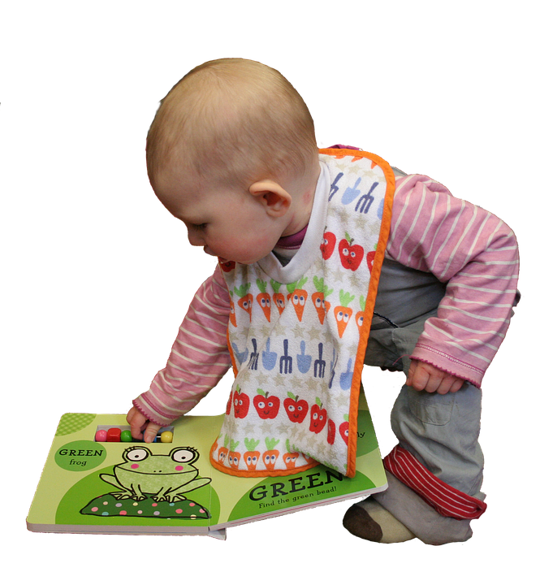
reading with your: Infant
Hold your baby on your lap while you read
Babies like board books, rhymes and songs from the same book or books over and over, make sure to point to and label pictures
This Photo by Unknown Author is licensed under CC BY-NC-ND

Slide 5
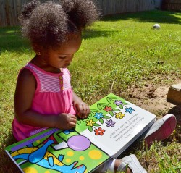
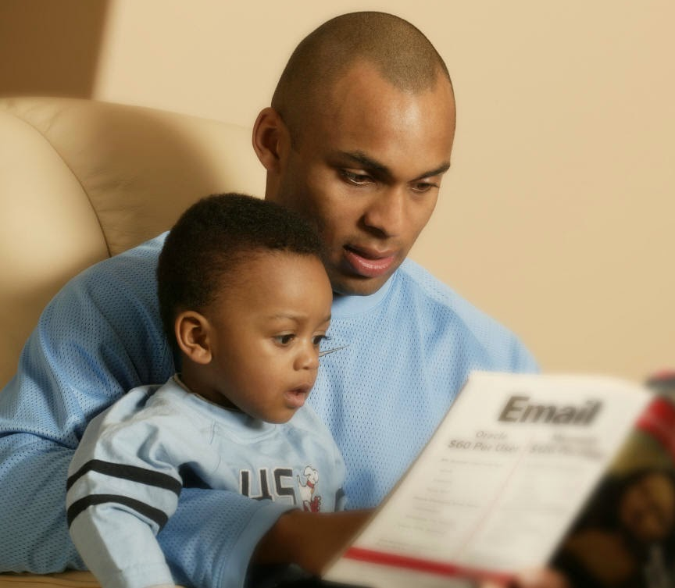
reading with your: Toddler
Allow your toddler move around while you are reading – toddlers’ attention span is about 5 minutes.
Read the same book over and over – toddlers love repetition
Let your child choose which books to read
Toddlers like to help turn the pages, fill in the words, and point and name the pictures in the story. Encourage their efforts and repeat their sounds/words.
This Photo by Unknown Author is licensed under CC BY-NC-ND and CC BY-SA

Slide 6
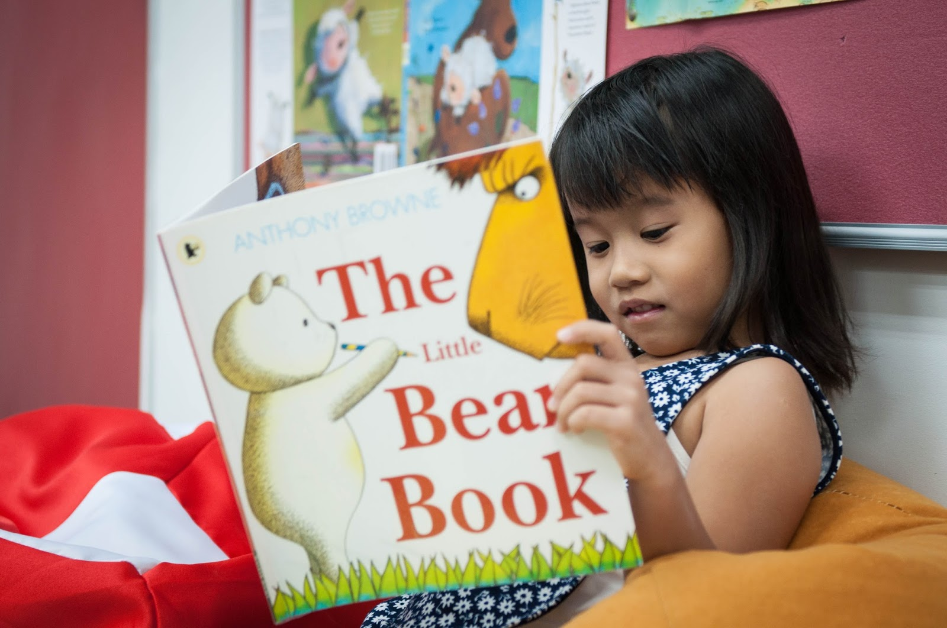
reading with your: Preschooler
Have your child sit close or on your lap while reading
Ask questions about the story
Let your child tell you stories or read you the book
Children like books with or without words and with many pictures
Children also enjoy books about people and events such as families, friends, first day of school, new sibling, visiting the dentist or doctors, etc.
This Photo by Unknown Author is licensed under CC BY-NC-ND and CC BY-SA-NC

Slide 7
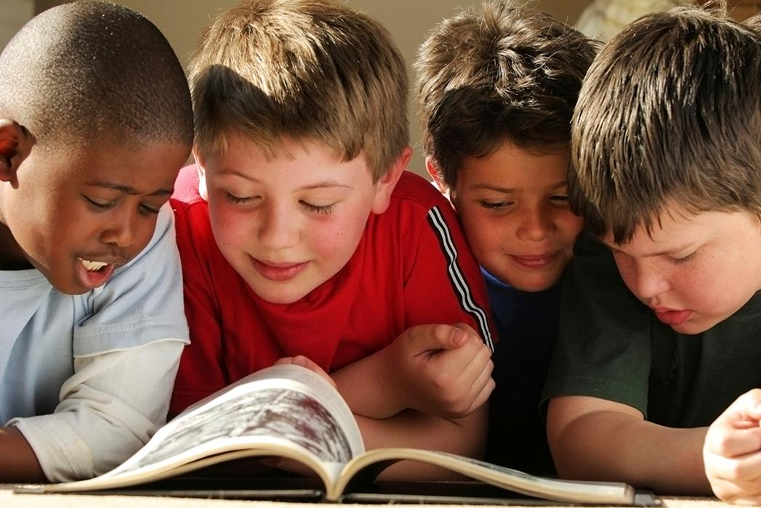
reading with: all young children
Read everyday
Read labels and signs wherever you go
Ask your child what he or she thins the book will be about based on the cover
Encourage your child to tell/read the story based on the pictures
For younger children, use your finger to show the words you are reading
Make reading fun by being expressive, making silly sounds, and singing
Choose relatable books that tell about day to day activities, special events/holidays, or cultural practices
Ask questions
Encourage your child ask questions
Visit your local the Library often – sometimes children as young as 4 can receive a library card
This Photo by Unknown Author is licensed under CC BY-ND

Slide 8
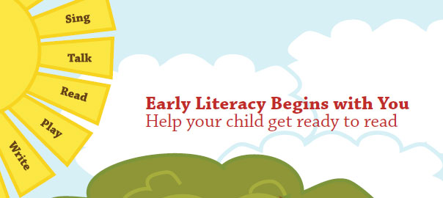
Works Cited
Kupcha-Szrom, Jaclyn. “A Window to the World: Early Language and Literacy Development.” ZERO TO THREE, Feb. 2011, www.zerotothree.org/resources/1021-a-window-to-the-world-early-language-and-literacy-development
School, Hampton Primary. “How to Read with Your Child.” YouTube, YouTube, 1 May 2014, www.youtube.com/watch?v=-OG2Q6pPQYw.

